Slide 1
SUPERVISED ML ALGORITHMS
E54 ADEEB KHAN E56 PRATHAM ACHARYA E03 VAIBHAV EKSAMBE
E55 ANSHJEET MAHIR E57 AMAR KHAKHKHAR ﻿

Slide 2

WHAT IS ML?
Machine learning is a subfield of computer science that explores the study and construction of algorithms that can learn from and make predictions on data. Such algorithms operate by building a model from example inputs in order to make data-
driven predictions or decisions, rather than following strictly static program instructions.

Slide 3
—Nick Bostrom
“Machine intelligence is the last invention that humanity will ever need to make.”

Slide 4

TYPES OF ML
Supervised
Unsupervised
Learn by examples as
to what a face is in terms of structure, color,
etc so that after several iterations it learns
to define a face.
Since there is no
desired output in this case that is provided therefore categorization is done so that the algorithm differentiates correctly between
the face of a horse, cat or human.

Slide 5
EXPLANATION
85%
40%
Supervised
Unsupervised

Slide 6
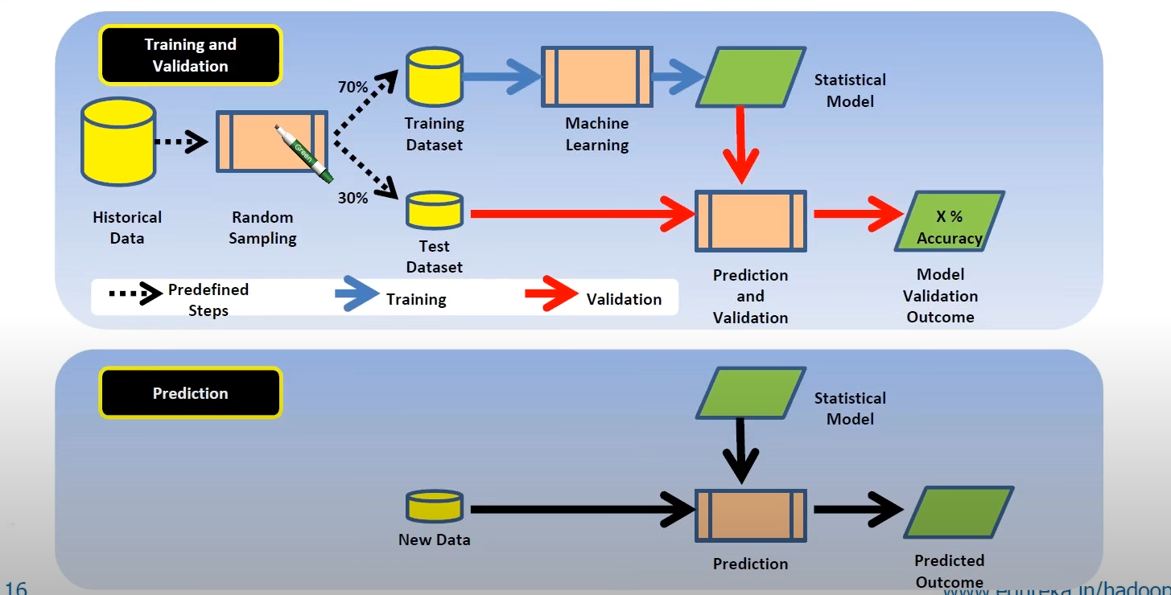
WORKLFOW

Slide 7
OVERVIEW DIAGRAM
Neural networks
Linear regression
ALGOS
Support vector machines
K-nearest neighbor
Naive bayes
Logistic regression
Popularly used ML algorithms
Random forest

Slide 8
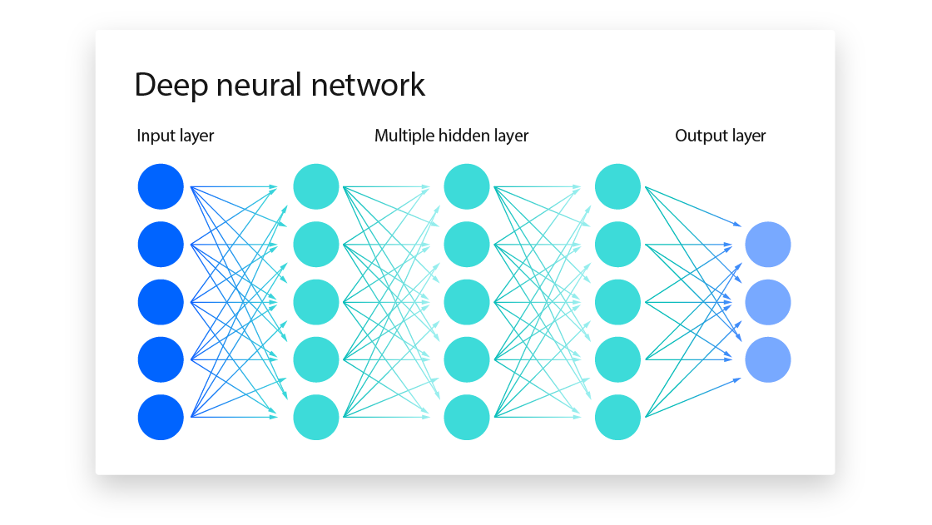
Neural Networks
Used for speech recognition, natural language processing, recommendation engines and computer vision
Notes:
A neural network is a method in artificial intelligence that teaches computers to process data in a way that is inspired by the human brain. It is a type of machine learning process, called deep learning, that uses interconnected nodes or neurons in a layered structure that resembles the human brain. It creates an adaptive system that computers use to learn from their mistakes and improve continuously. Thus, artificial neural networks attempt to solve complicated problems, like summarizing documents or recognizing faces, with greater accuracy.

Slide 9
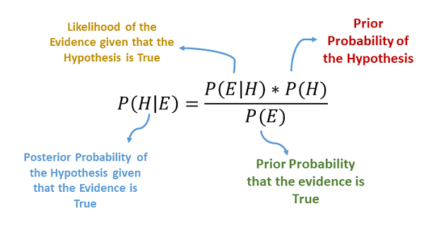
Naïve Bayes
Used for spam filtration, Sentimental analysis, credit scoring, and classifying articles.
Notes:
A neural network is a method in artificial intelligence that teaches computers to process data in a way that is inspired by the human brain. It is a type of machine learning process, called deep learning, that uses interconnected nodes or neurons in a layered structure that resembles the human brain. It creates an adaptive system that computers use to learn from their mistakes and improve continuously. Thus, artificial neural networks attempt to solve complicated problems, like summarizing documents or recognizing faces, with greater accuracy.

Slide 10
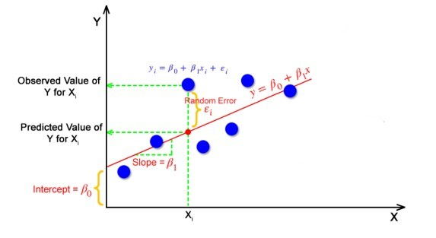
Linear Regression
Used for pricing, risk analysis, and sports analysis.
Notes:
A neural network is a method in artificial intelligence that teaches computers to process data in a way that is inspired by the human brain. It is a type of machine learning process, called deep learning, that uses interconnected nodes or neurons in a layered structure that resembles the human brain. It creates an adaptive system that computers use to learn from their mistakes and improve continuously. Thus, artificial neural networks attempt to solve complicated problems, like summarizing documents or recognizing faces, with greater accuracy.

Slide 11
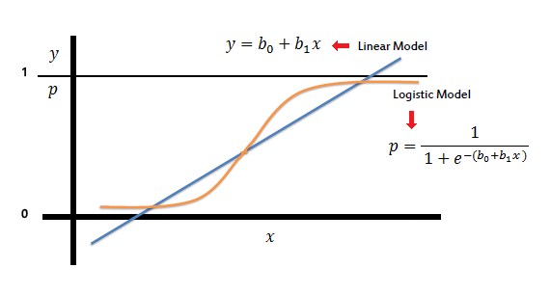
Logistic Regression
Used for fraud detection, disease predicition, i.e. for classification and prediction cases
Notes:
A neural network is a method in artificial intelligence that teaches computers to process data in a way that is inspired by the human brain. It is a type of machine learning process, called deep learning, that uses interconnected nodes or neurons in a layered structure that resembles the human brain. It creates an adaptive system that computers use to learn from their mistakes and improve continuously. Thus, artificial neural networks attempt to solve complicated problems, like summarizing documents or recognizing faces, with greater accuracy.

Slide 12
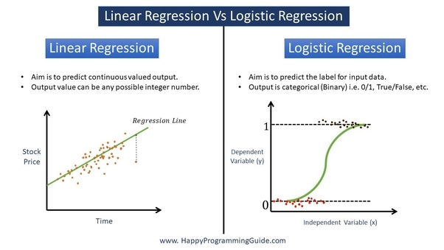
Difference between logistic and linear regression

Slide 13
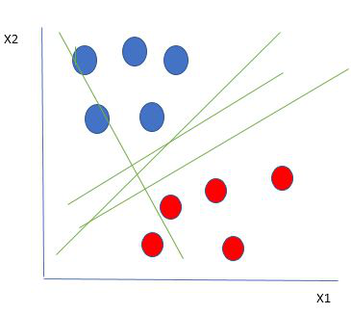
Support Vector Machines
Used for face detection ,text characterisation, classification of images, bioinformatic and handwriting recognition
Notes:
A neural network is a method in artificial intelligence that teaches computers to process data in a way that is inspired by the human brain. It is a type of machine learning process, called deep learning, that uses interconnected nodes or neurons in a layered structure that resembles the human brain. It creates an adaptive system that computers use to learn from their mistakes and improve continuously. Thus, artificial neural networks attempt to solve complicated problems, like summarizing documents or recognizing faces, with greater accuracy.

Slide 14
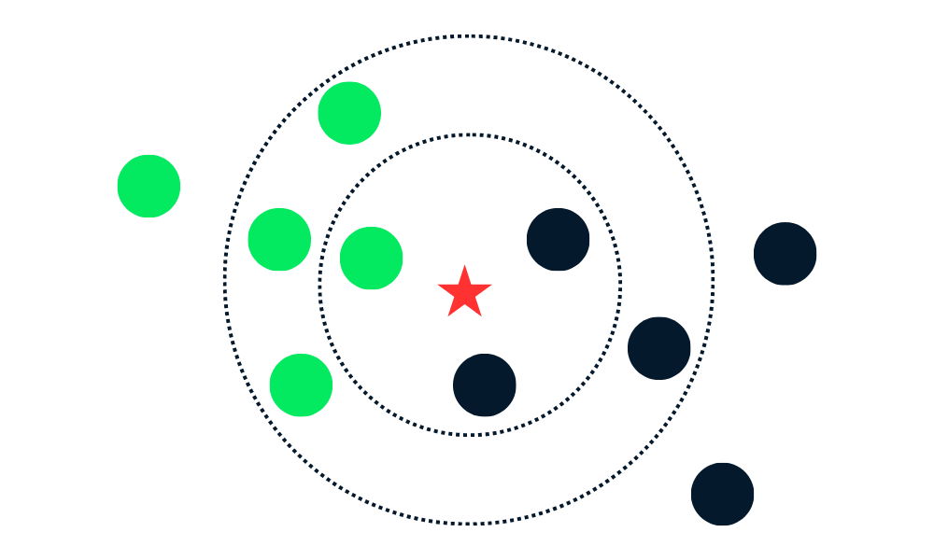
K nearest neighbor
Used for simple recommendation systems, pattern recognition, data mining, financial market predictions, intrusion detection,
Notes:
A neural network is a method in artificial intelligence that teaches computers to process data in a way that is inspired by the human brain. It is a type of machine learning process, called deep learning, that uses interconnected nodes or neurons in a layered structure that resembles the human brain. It creates an adaptive system that computers use to learn from their mistakes and improve continuously. Thus, artificial neural networks attempt to solve complicated problems, like summarizing documents or recognizing faces, with greater accuracy.

Slide 15
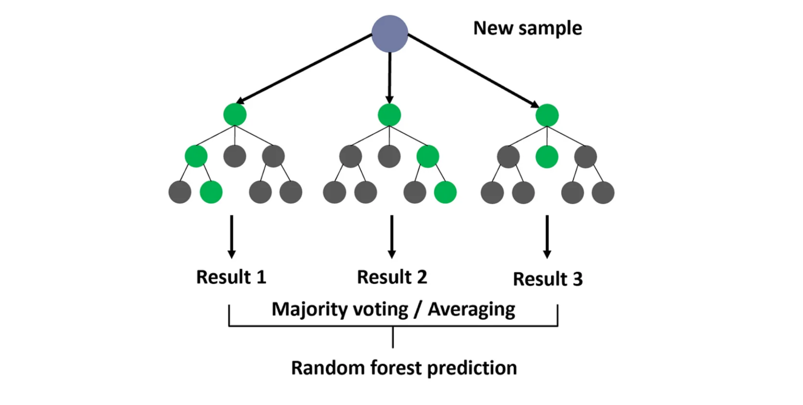
Random forests
Used for banking industries(customer segmentation), healthcare(breast cancer prediction) and medicine, stock market, and ecommerce(product recommendation)
Notes:
A neural network is a method in artificial intelligence that teaches computers to process data in a way that is inspired by the human brain. It is a type of machine learning process, called deep learning, that uses interconnected nodes or neurons in a layered structure that resembles the human brain. It creates an adaptive system that computers use to learn from their mistakes and improve continuously. Thus, artificial neural networks attempt to solve complicated problems, like summarizing documents or recognizing faces, with greater accuracy.

Slide 16
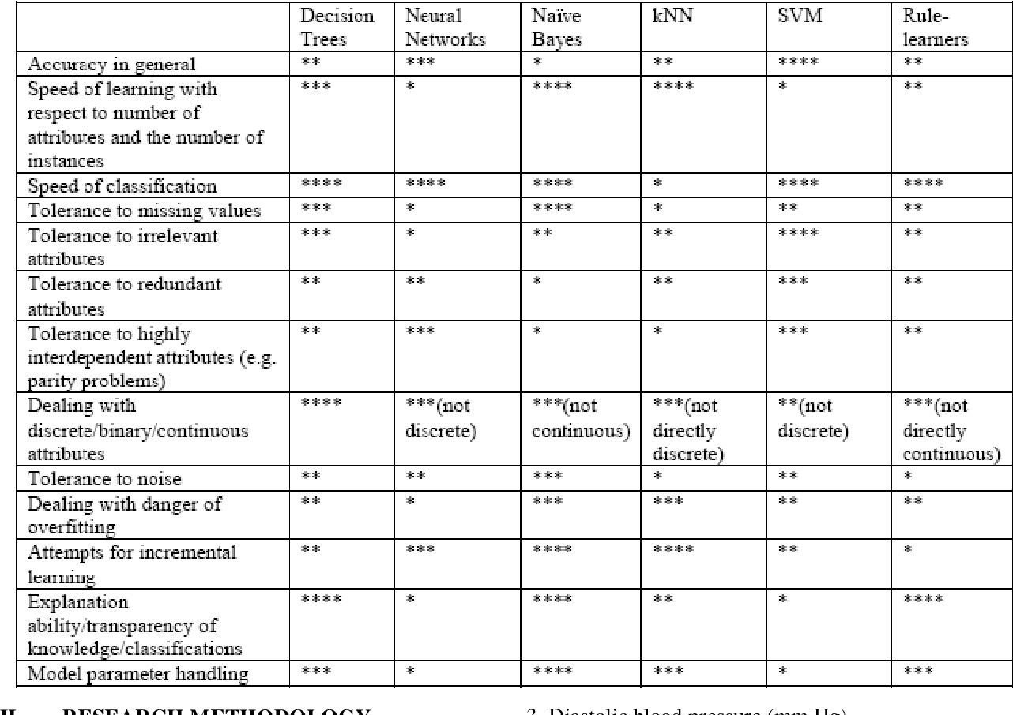
Brief comparision

Slide 17
THANKS !

